Slide 1
Spring AOP
Instruction: NGUYEN ANH MINH (M. Sc.)

Slide 2
Outline
Implementing aspect behavior
AspectJ APIs and annotations
Spring AOP application

Slide 3
Aspect behavior

Slide 4
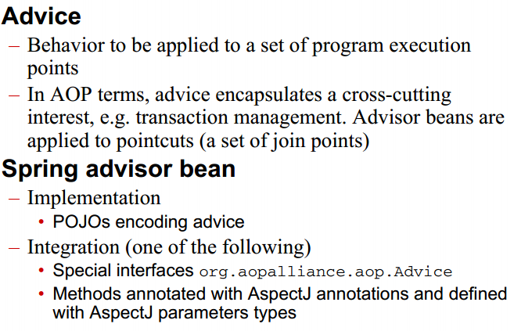
Aspect behavior

Slide 5
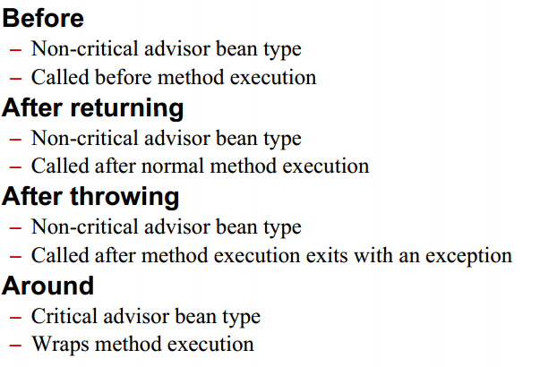
Advice types

Slide 6
Before advice

Slide 7
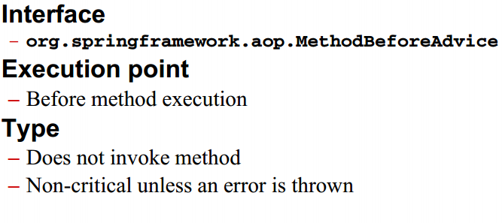
Before advice

Slide 8
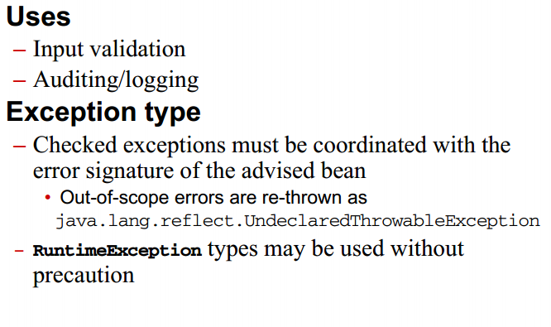
Before advice guideline

Slide 9
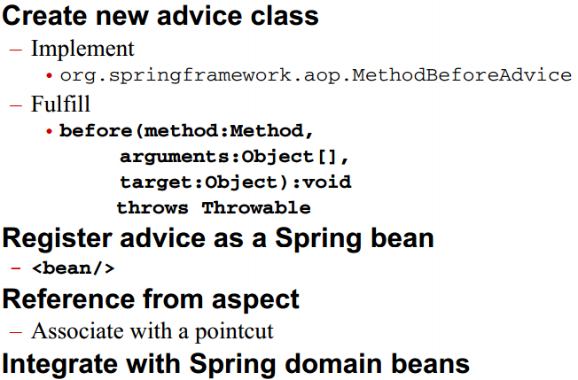
Before advice process

Slide 10
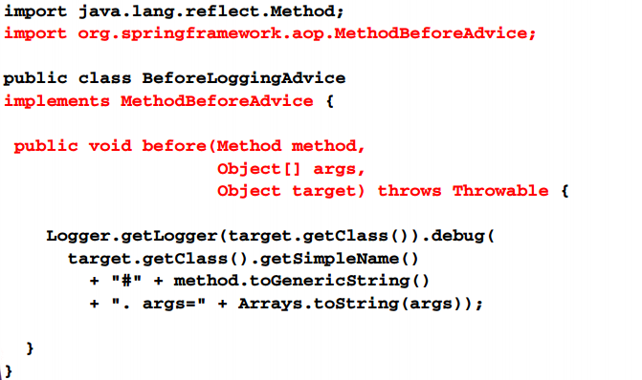
Create before advice class

Slide 11
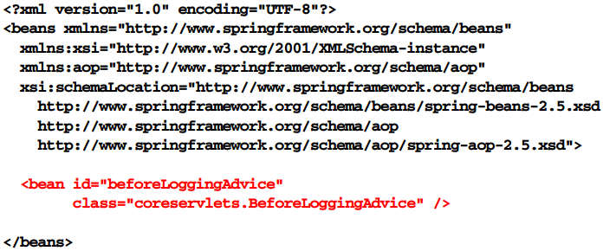
Register before advice bean

Slide 12
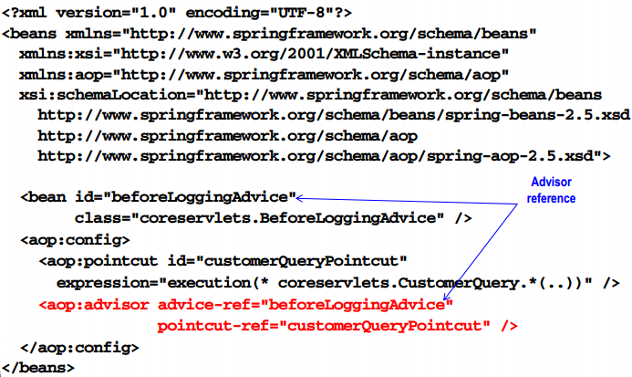
Reference from aspect

Slide 13
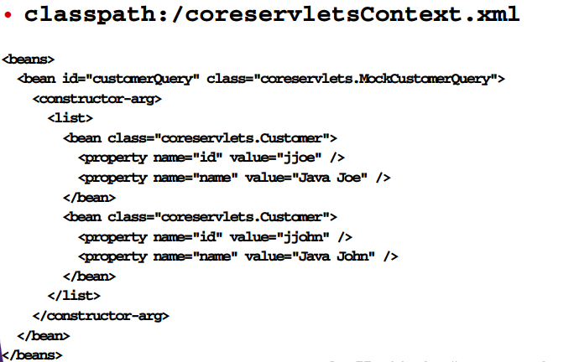
Domain beans

Slide 14
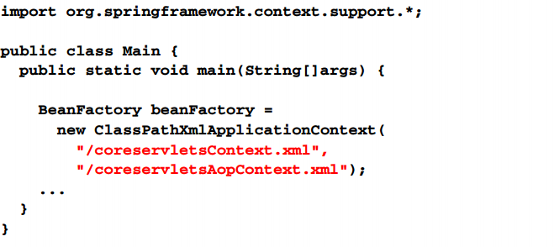
Integrate advice with domain beans

Slide 15
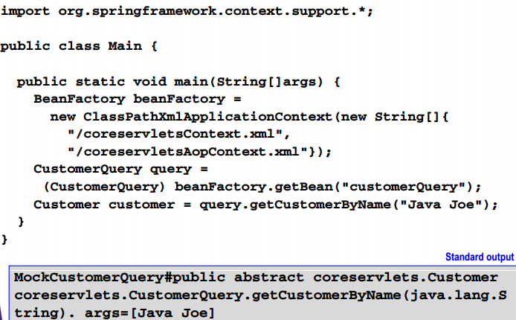
Access and use beans

Slide 16
After returning advice

Slide 17
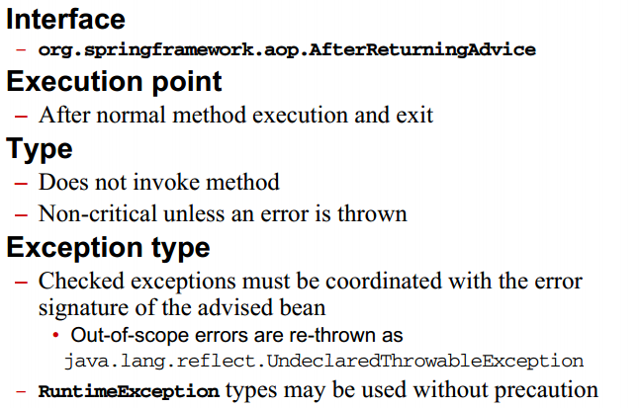
After returning advice

Slide 18
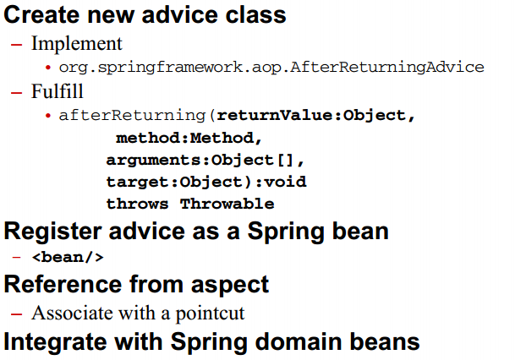
After returning advice

Slide 19
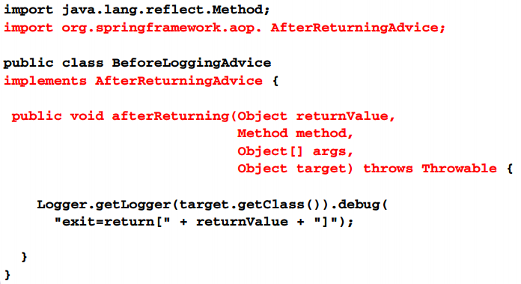
After returning advice class

Slide 20
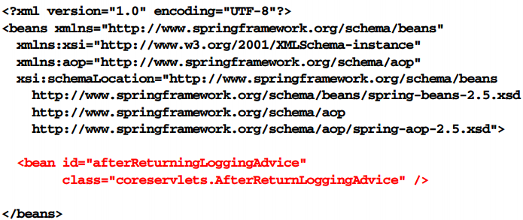
Register after returning advice bean

Slide 21
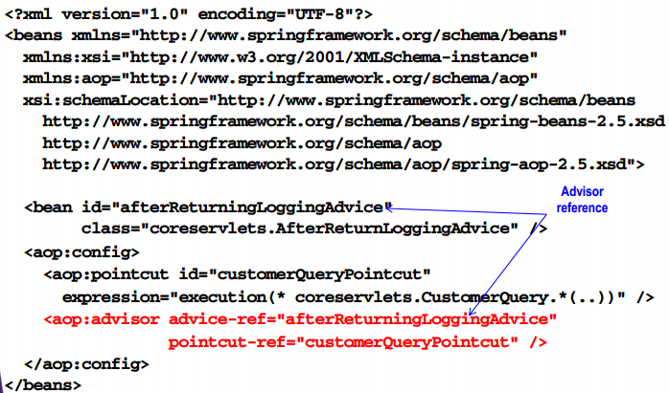
Reference from aspect

Slide 22
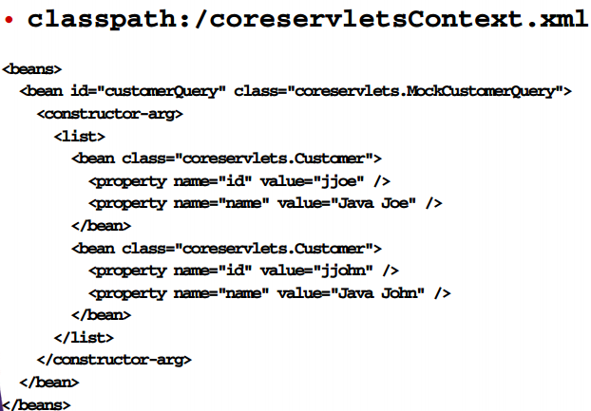
Domain beans

Slide 23
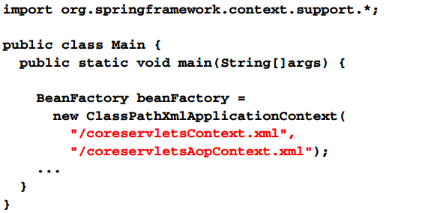
Integrate advice with domain bean

Slide 24
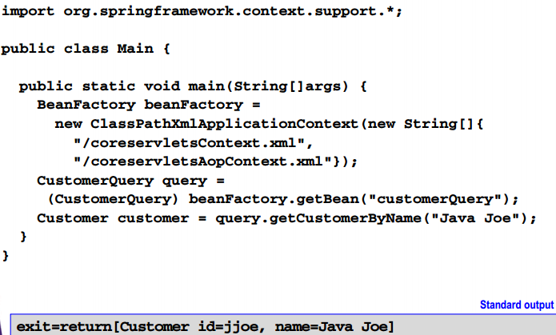
Access and use beans

Slide 25
Throw advices

Slide 26
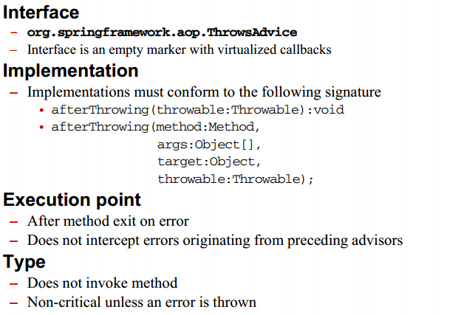
Throws advice

Slide 27
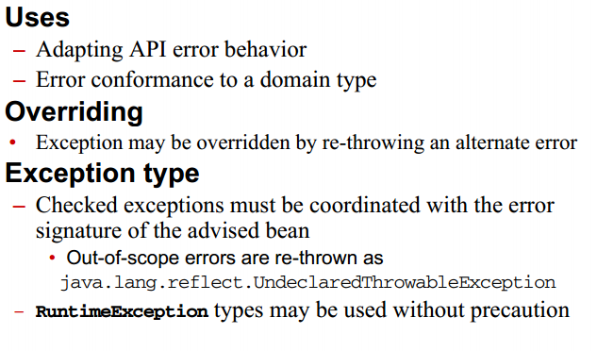
Throw advice guideline

Slide 28
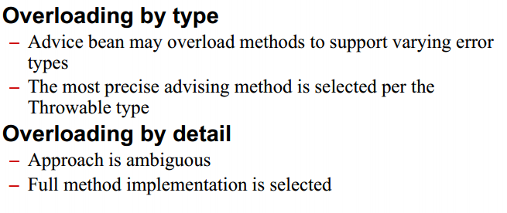
Throw advice guidelines

Slide 29
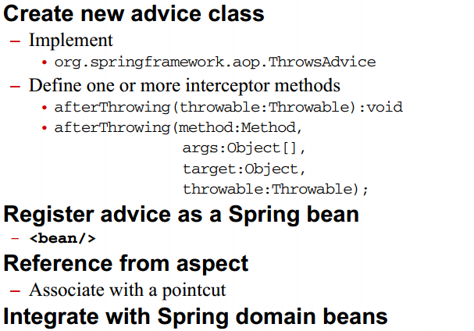
Throw advice process

Slide 30
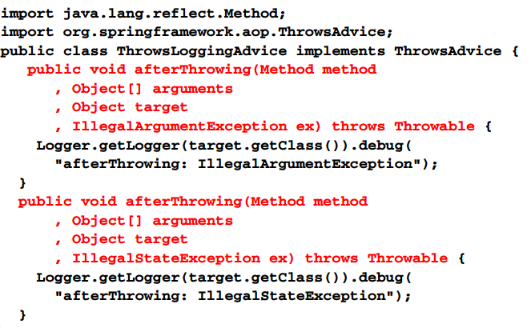
Throw advice class

Slide 31
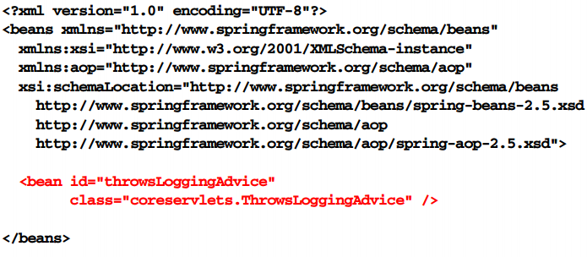
Register throws advice bean

Slide 32
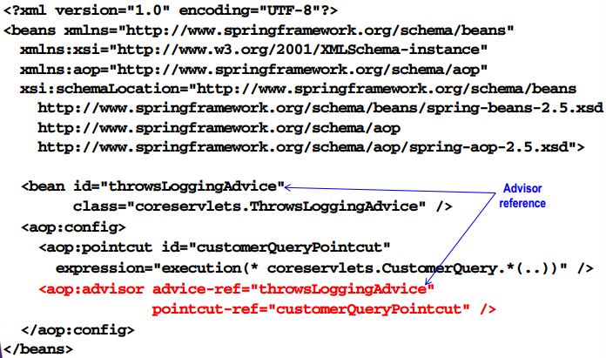
Reference from Aspect

Slide 33
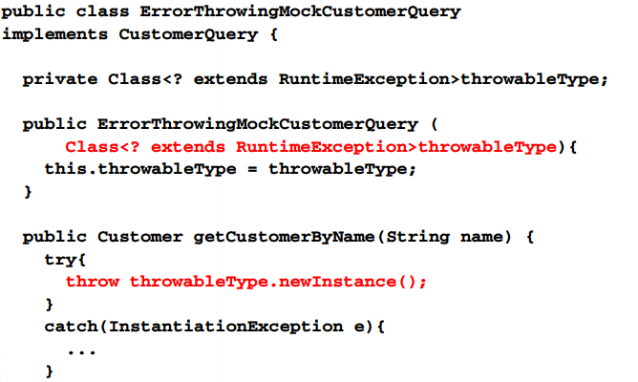
Mock domain class

Slide 34
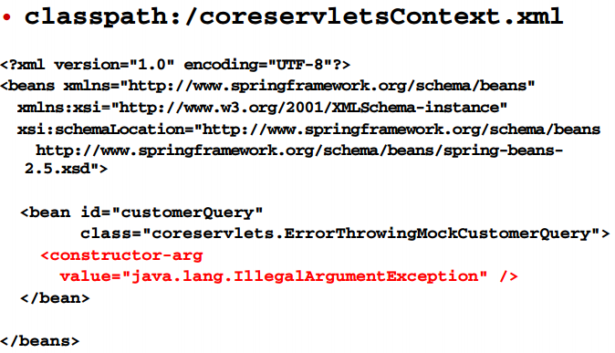
Domain beans

Slide 35
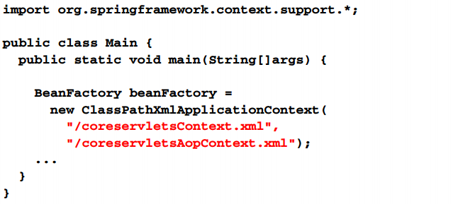
Integrate advice with domain bean

Slide 36
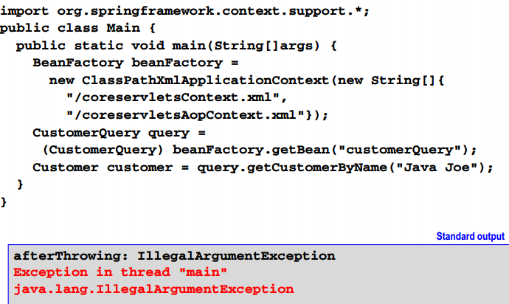
Access and use Beans

Slide 37
Around advice

Slide 38
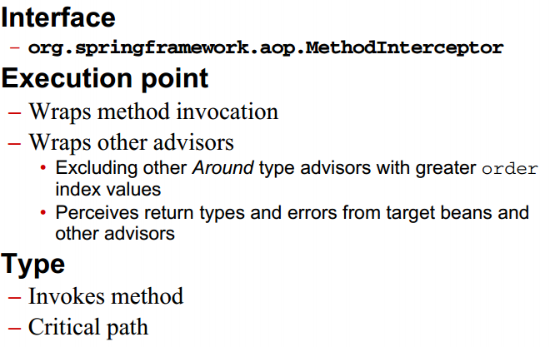
Around advice

Slide 39
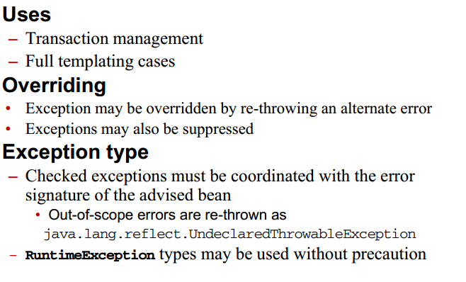
Around advice guidelines

Slide 40
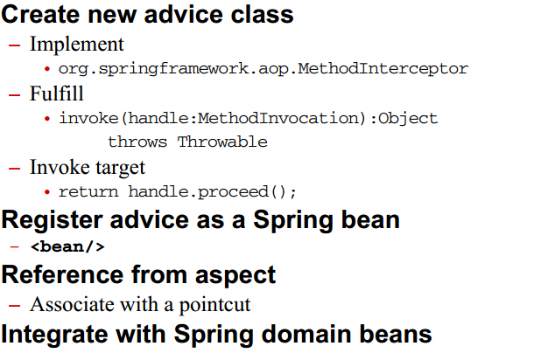
Around advice process

Slide 41
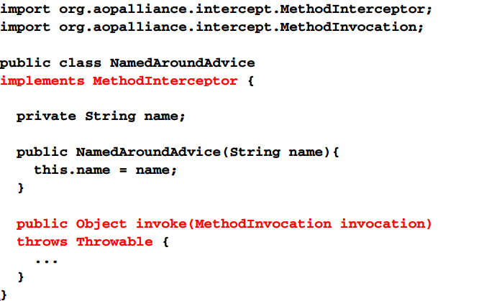
Around advice class

Slide 42
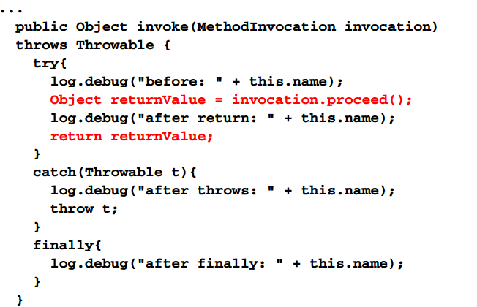
Around advice class

Slide 43
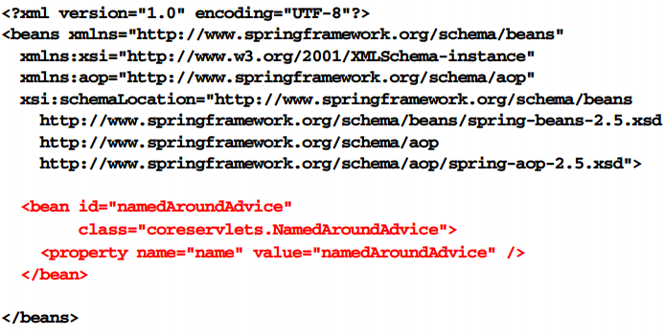
Register around advice bean

Slide 44
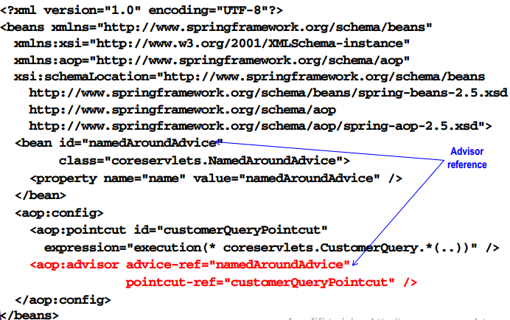
Reference from aspect

Slide 45
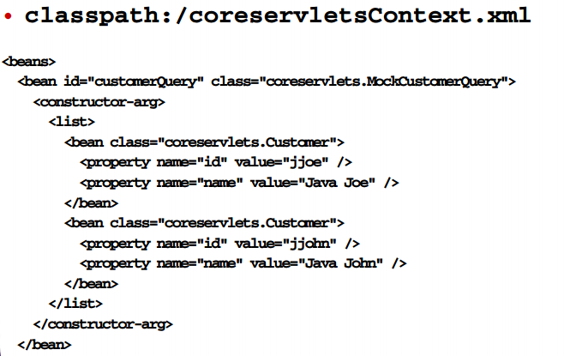
Domain beans

Slide 46
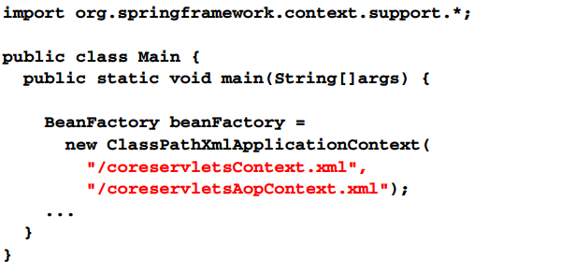
Integrate advice with domain bean

Slide 47
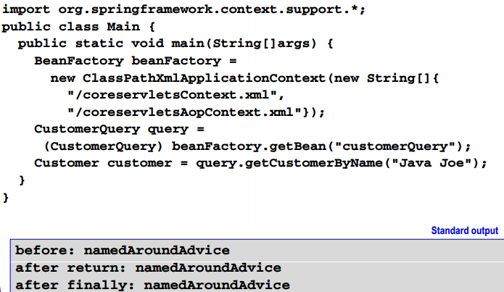
Access and use beans

Slide 48
Advice ordering

Slide 49
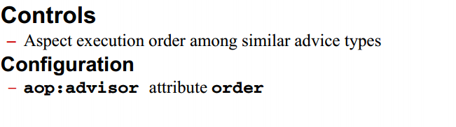
Around advice

Slide 50
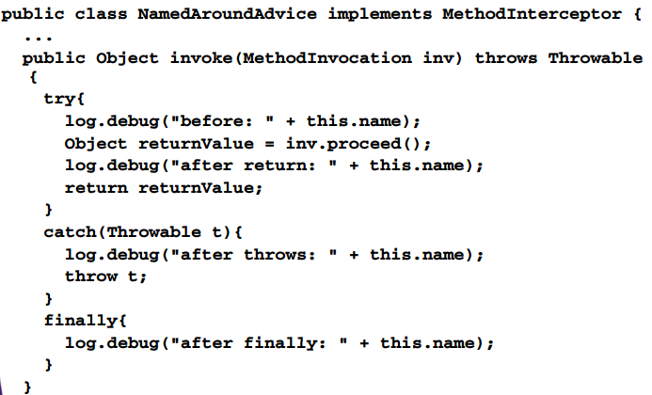
Around advice class

Slide 51
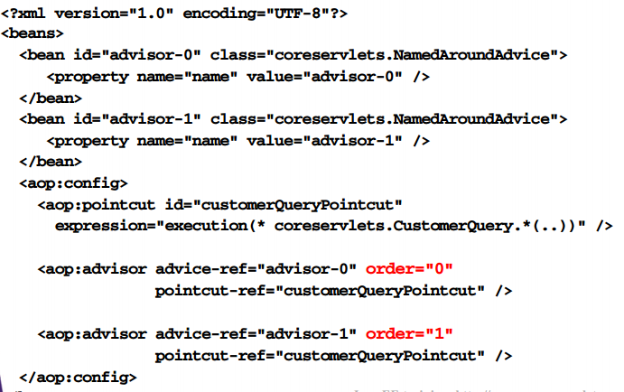
Configure Aspect Order

Slide 52
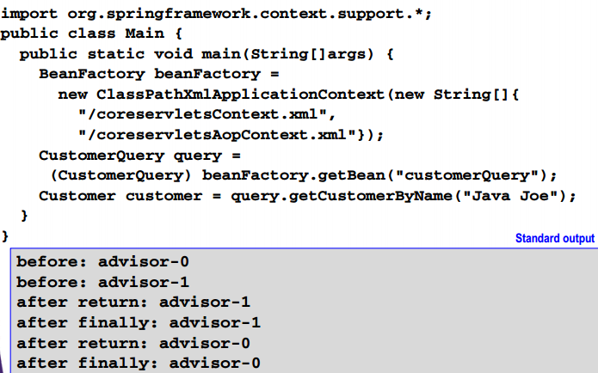
Access and use Beans

Slide 53
AspectJ pointcuts

Slide 54
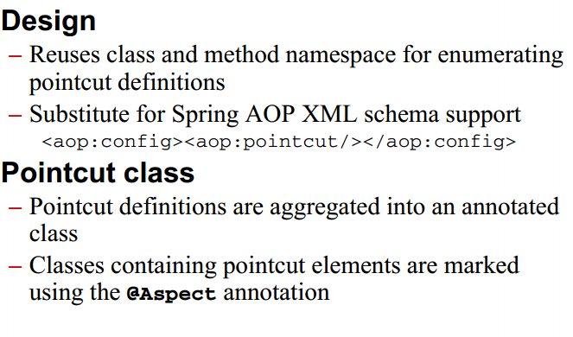
AspectJ pointcuts introducion

Slide 55
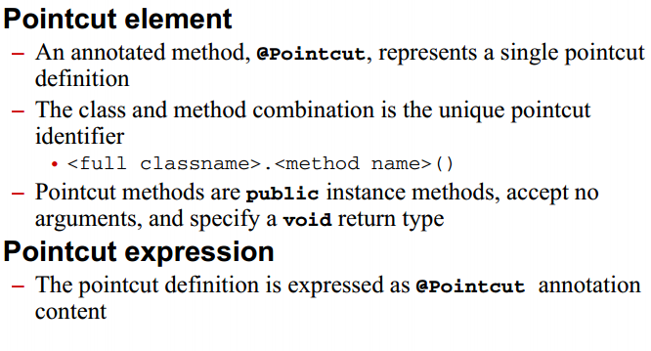
AspectJ pointcut introdution

Slide 56
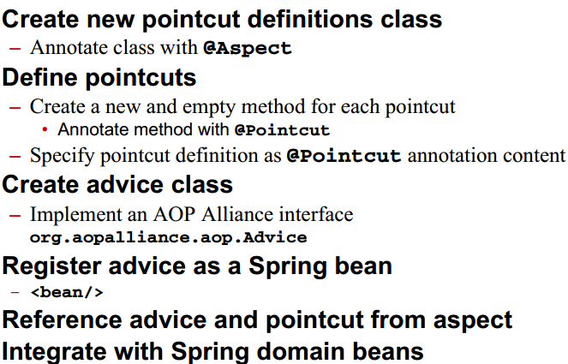
AspectJ pointcut process

Slide 57
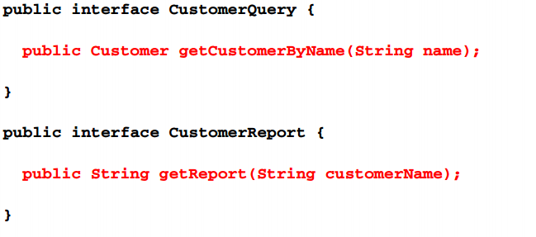
Select join point

Slide 58
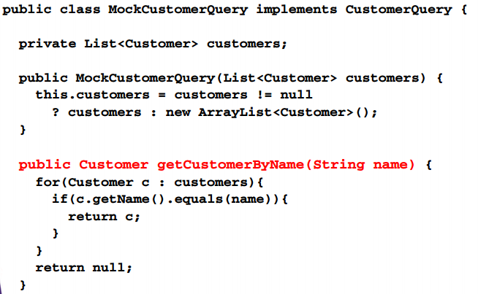
Select join point

Slide 59
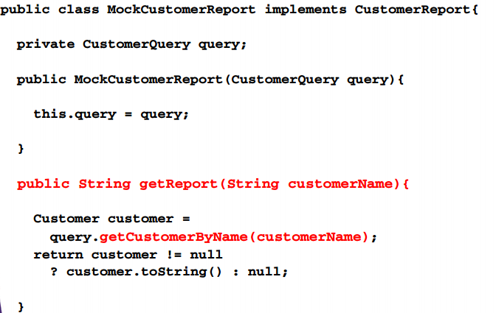
Select join point

Slide 60

Create pointcut definition class

Slide 61

Define pointcut

Slide 62

Create advice class

Slide 63

Register advice bean

Slide 64

Define aspect

Slide 65

Domain beans

Slide 66

Access and use beans

Slide 67
AspectJ advice

Slide 68

AspectJ advice introduction

Slide 69

AspectJ advice

Slide 70

AspectJ pointcut process

Slide 71

AspectJ pointcut process

Slide 72

Select join points

Slide 73

Select join points

Slide 74

Select join points

Slide 75

Define pointcuts

Slide 76

Create advice class

Slide 77

Create advice class

Slide 78

Register advice bean

Slide 79

Register bean postprocessor

Slide 80

Domain beans

Slide 81

Access and use beans

Slide 82
AspectJ advice with spring AOP xml

Slide 83

AspectJ advice with spring aop xml

Slide 84

Process

Slide 85

Create advice class

Slide 86

Register advice bean

Slide 87

Define pointcut

Slide 88

Define pointcut

Slide 89

Domain beans

Slide 90

Access and use Beans

Slide 91
Spring AOP application

Slide 92

JDBC transaction management using AOP

Slide 93

JDBC transaction management using AOP

Slide 94

Process

Slide 95

Process

Slide 96

Process

Slide 97

Develop persistence library

Slide 98

Develop persistence library

Slide 99

Develop persistence library

Slide 100

Select join points

Slide 101

Create bean definitions

Slide 102

Create spring AOP/tx definitions

Slide 103

Register transaction manager

Slide 104

Register advice bean

Slide 105

Define pointcut

Slide 106

Define aspect

Slide 107

Initializer container

Slide 108

Test transaction manager

Slide 109

Summary

Slide 110

Summary

